Slide 1
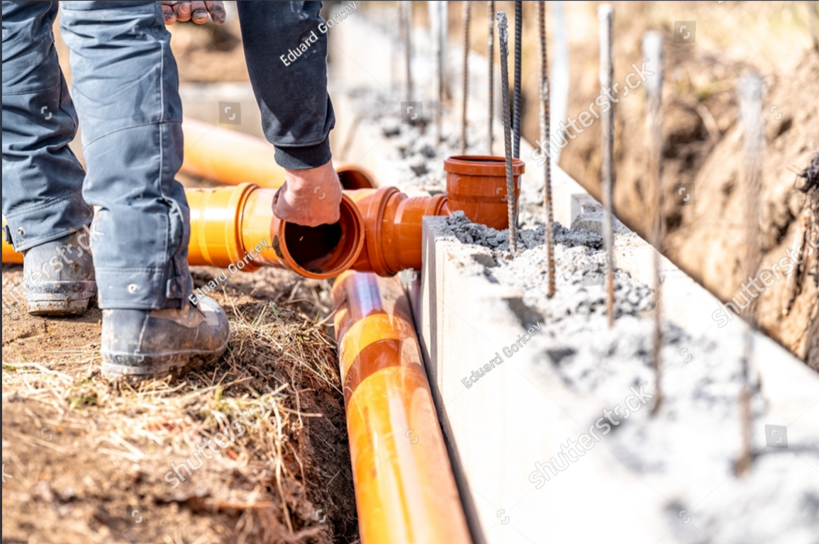
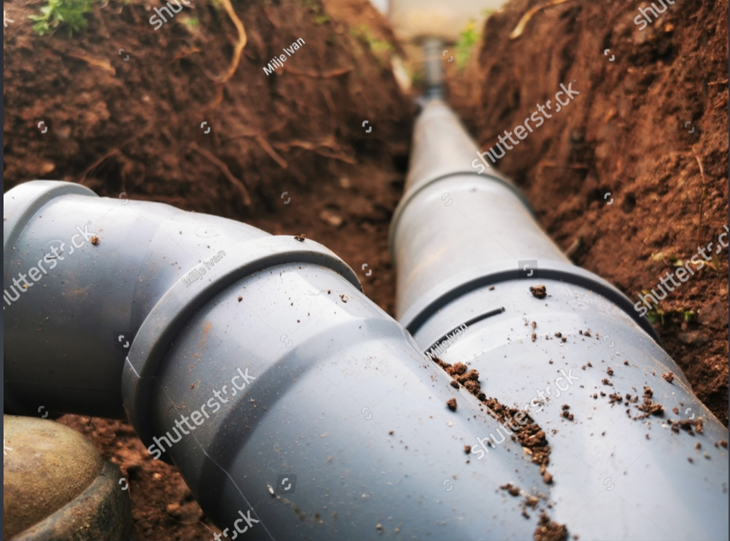
Drainage ditches
Project
Implementing a comprehensive maintenance and upgrade program for drainage ditches
to optimize water flow and mitigate environmental risks.
Name: Eswar Sri Satya Sai Kadali
Roll no: S20210020271

Slide 2
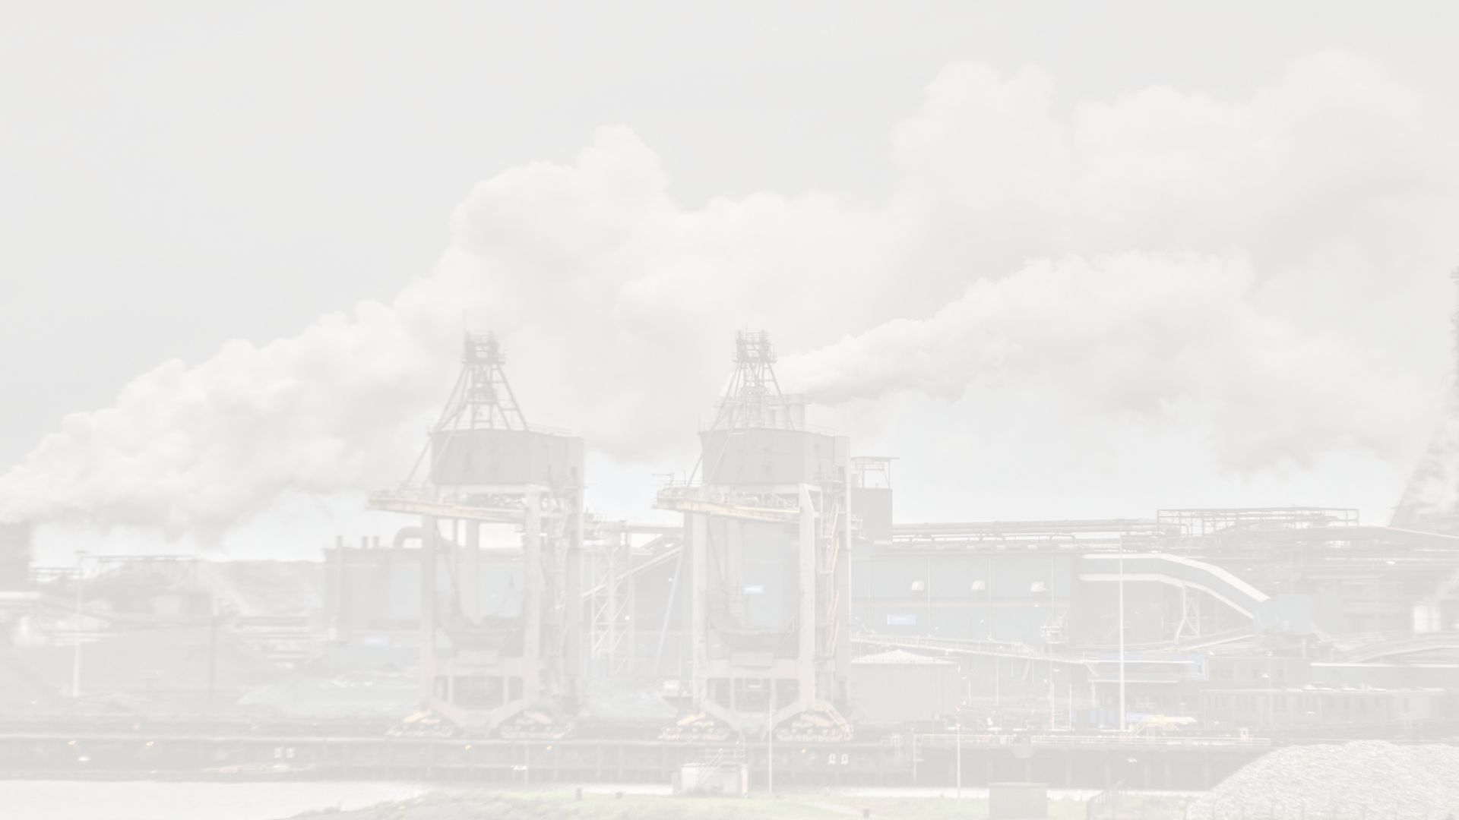
Motivation for the Project
1
Strategic Planning Necessity
Comprehensive Site Assessment
3
Balancing Industry and Environment
2
Identify optimal locations for drainage projects by assessing factors such as topography, soil composition, existing drainage infrastructure, land use patterns, and anticipated development. Considerations should also include potential environmental impacts, community needs, and long-term sustainability to ensure effective water management and mitigation of flooding risks.
Identify optimal locations for drainage ditches by evaluating topography,
soil composition, existing infrastructure, and environmental considerations.
Assess potential economic benefits through improved water management
and reduced flood risk for the local community.
Utilizing GIS tools such as QGIS, the project seeks to identify drainage ditch locations that fulfill industrial necessities while mitigating adverse effects, facilitating sustainable water management, and preserving ecological balance.
I

Slide 3
Individual Contribution
Data Collection
Advanced Data Processing
Insightful Analysis and Visualization
I specialized in gathering crucial raster layers for the project. Using GIS knowledge, I ensured the acquisition of key datasets like satellite imagery, ensuring a thorough representation of the study area.
My role extended to processing the collected raster layers in QGIS. I applied advanced techniques, including raster-to-vector conversion and contour generation, to extract meaningful insights from the data, a vital step for informed analysis.
With expertise in spatial analysis and visualization using QGIS, I conducted detailed assessments of the raster layers. This enabled the identification of potential drainage ditches based on factors like topography and land cover.

Slide 4
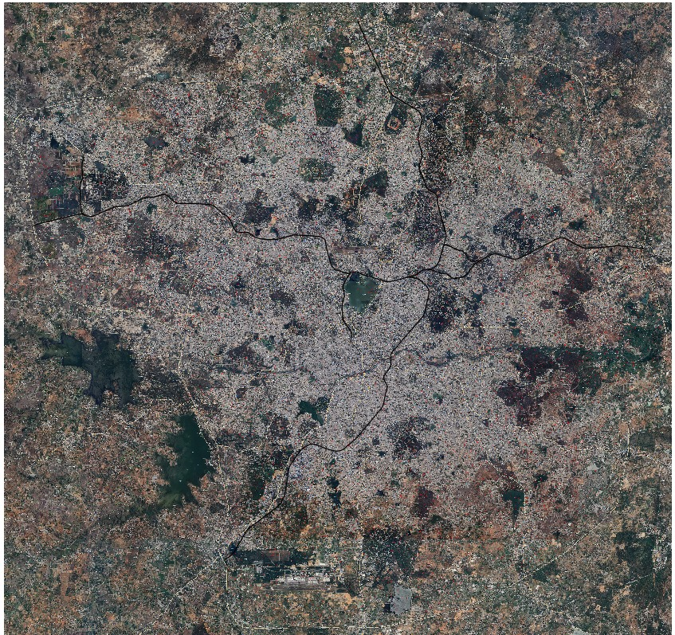
List of Datasets Used
Satellite Imagery :
Vector Layers :
High-resolution satellite images for site mapping and land use analysis.
Rivers layer
Water Bodies
Tank Layer
Inundation Layer
Structure Layer
Forest , vegetation Layer

Slide 5
Use of Each Layer
1
Rivers Layer
2
Water Bodies
to know flow of water in and out of the city and various channels or drains across city.
locate various places where lakes , ponds etc.. located inside the city.
3
Tank Layer
4
Forest , vegetation Layer
locate various storage facilities of water in the city
Locates existing structures, helping in urban planning, assessing space availability, and potential land use conflicts
5
Inundation Layer
6
Structures Layer
locate areas of flooding in the city caused by uneven flow of water through drains.
points to various bridges or culverts built across the drain line or river flow channels etc

